Slide 1
Lecture 4. String
Instructor: 黄群
huangqun@pku.edu.cn
School of EECS
Peking University

Slide 2
Outline
String
Basic concepts & Operations (ADT)
Implementation
Pattern Matching
2

Slide 3
Example
s1=“123”
s2=“ABBABBC”
s3=“BB”
s4=“BB ”
s5=“Hello World!”
s5=“”

Slide 4
Basic Concepts
String: a special type of linear list
Element: zero or more characters in a sequential
Length: the number of characters in a string
Empty string: a string with zero length
S : “c₀c₁c₂…c_{n-1}”
String Value
String Name
c_{i:} String Element
4

Slide 5
Comparison with General Linear List
Data type
General list: arbitrary type
String: characters
Implementation
String can be implemented in the same method of general list (array or linked list)
Array is more popular
Operations
General list: operations for a single element
String: operations for an entire string
String supports all operations of general list

Slide 6
Character (Char)
Elements in string
Charset
Binary：Σ = {0,1}
DNA：Σ = {A,C,G,T}
English： Σ = {26个字符，标点符号}
Character Encoding
Represent a charset in computation, storage, and transmission

Slide 7
Example of Charset and Encoding
ASCII
Elements: 128 characters
Coding: single byte (7 bits actually)
Used in C/C++
Unicode: charset with >1M characters
Assign each character an integer, but not encoding
UTF-8: an encoding for Unicode, 1~4 bytes / character
Other
EASCI
GB:
GB 2312 (双字节, 6763汉字), GBK (双字节, 21886汉字与图形), GB18030 (多字节, 70244汉字与图形)
CJK

Slide 8
Example of Charset and Encoding
手持两把锟斤拷，
口中疾呼烫烫烫。
脚踏千朵屯屯屯，
笑看万物锘锘锘。
“程序输出烫烫烫烫烫烫， 是不是CPU过热要拔电源？”

Slide 9
Example of Charset and Encoding
Undefined character in Unicode: '0xFFFD'
Encoded in UTF-8 (3 bytes): '0xEF 0xBF 0xBD’
手持两把锟斤拷，
口中疾呼烫烫烫。
脚踏千朵屯屯屯，
笑看万物锘锘锘。
“程序输出烫烫烫烫烫烫， 是不是CPU过热要拔电源？”
UTF-8:
'0xEF 0xBF 0xBD 0xEF 0xBF 0xBD'
GB:
锟(0xEFBF)
斤(0xBDEF)
拷(0xBFBD)

Slide 10
Example of Charset and Encoding
Default values in Visual Studio
High Memory Address
Kernel
Stack growth
Stack
Uninitialized stack: 0XCC
烫(0xCCCC)
Unused
Dynamic libraries
Unused
Uninitialized heap: 0XCD
屯(0xCDCD)
Heap growth
Heap
Freed heap: 0XDD
Read/write (.data, .bss)
Read only (.text, .init)
Fence of heap: 0XFC
Reserved
Low Memory Address

Slide 11
Example of Charset and Encoding
Some Windows applications insert invisible characters in the beginning of a text file
Called BOM
Indicate byte order
Encoded in UTF-8 (3 bytes): 0xEF 0xBB 0xBF’
But BOM is not necessary in other platforms
They treat the inserted characters as normal
Avoid Windows built-in applications ☺
UTF-8:
0xEF 0xBB 0xBF 0xEF 0xBB 0xBF
GB:
锘(0xEFBB)
匡(0xBFEF)
豢(0xBBBF)

Slide 12
Data Type of String
Vary across languages
Array of characters: C
Class: C++/JAVA
Built-in type: Python
String constants
e.g., “\n”
String variables
char* str = …; (C-style character sequence)
string str = …; (C++-style STL string)
12

Slide 13
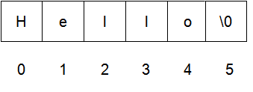
C Strings
Char array: need to deal with storage structure
Terminated by ‘\0’
String length: 5
Actual bytes in memory: 6

Slide 14
Operations in C
// calculate the length of a string
size_t strlen ( const char * str );
// compare two strings
// <0: str1 < str2
// =0: equal
// >0: str1 > str2
int strcmp ( const char * str1, const char * str2 );
// read/write formatted data from/to strings
int sscanf(const char* str, const char* format, …);
int sprintf(char* str, const char* format, …);

Slide 15
Operations in C (Copying)
char* strcpy ( char* dest, const char* src);
char* strncpy ( char* dest, const char* src , size_t num);
void* memcpy ( void * destination, const void * source, size_t num);
void* memmove ( void * destination, const void * source, size_t num);

Slide 16
Operations in C (Concatenation)
char * strcat ( char * destination, const char * source );
char * strncat ( char * destination, const char * source, size_t num );

Slide 17
Operations in C (Searching)
// search for a character
char* strchr(char* str, char character);
char* strrchr(char* str, char character);
// search for multiple characters (str2) in str1, return first occurrence
size_t strcspn ( const char * str1, const char * str2 );
// partition a string (str1) based on delimiters (str2)
char * strtok ( char * str1, const char * str2 );
// search for a substring (str2) in str1
char * strstr ( char * str1, const char * str2 );

Slide 18
C++ Strings
String class: hide underlying storage structure
Not in the form of fixed-length character sequences (char str[N])
A storage structure with dynamic lengths
Vary in C++ libraries
libstdc++
libc++
18

Slide 19
Operators in C++
Access a character
[]
Assignment
=
Concatenation
+
Comparison
<
<=
>
>=
!=
==
19

Slide 20
I/O Operators in C++
Input operator
>>
Output operator
<<
20

Slide 21
Operations in C++ (Capacity)
// length of a string
size_t size();
size_t length();
// actually storage space
size_t capacity();
// whether a string has element
bool empty();
// erase all characters
void clear();

Slide 22
Operations in C++ (Access & Modify)
// get c-style char array
const char* c_str();
// get a character
char& at (size_t pos); // same as operator []
char& front();
char& back();
// More: like a linear list
// append, assign, insert, erase, replace
// copy, swap
// push_back, pop_back

Slide 23
Operations in C++ (Searching)
// search for a character
size_t find (char c, size_t pos = 0);
// search for a C++ string
size_t find (const string& str, size_t pos = 0);
// search for a C-style string
size_t find (const char* s, size_t pos = 0);
size_t find (const char* s, size_t pos, size_t n);

Slide 24
Outline
String
Basic concepts & Operations (ADT)
Implementation
Pattern Matching
24

Slide 25
Key Idea
Recall that string is a specific type of linear list
Usually as character array
Most operations need to travel the whole char array

Slide 26
Implementations of String Operations
Get string length
int strlen(char* s);
Compare two strings
int strcmp(char* s1, char* s2);
Copy string
char* strcpy(char* s1, char* s2);
Concatenate strings
char* strcat(char* s1, char* s2);
26

Slide 27
Example: strlen()
/**
* strlen - Find the length of a string
* @s: The string to be sized
*/
size_t strlen(const char *s) {
const char *sc;
for (sc = s; *sc != '\0'; ++sc)
/* nothing */;
return sc - s;
}
https://github.com/raspberrypi/linux/blob/rpi-4.4.y/lib/string.c
27

Slide 28
Example: strcmp()
/**
* strcmp - Compare two strings
*/
int strcmp(const char *cs, const char *ct) {
unsigned char c1, c2;
while (1) {
c1 = *cs++;
c2 = *ct++;
if (c1 != c2)
return c1 < c2 ? -1 : 1;
if (!c1)
break;
}
return 0;
}
https://github.com/raspberrypi/linux/blob/rpi-4.4.y/lib/string.c
28

Slide 29
Example: strcpy()
/**
* strcpy - Copy a %NUL terminated string
* @dest: Where to copy the string to
* @src: Where to copy the string from
*/
char *strcpy(char *dest, const char *src) {
char *tmp = dest;
while ((*dest++ = *src++) != '\0')
/* nothing */;
return tmp;
}
https://github.com/raspberrypi/linux/blob/rpi-4.4.y/lib/string.c
29

Slide 30
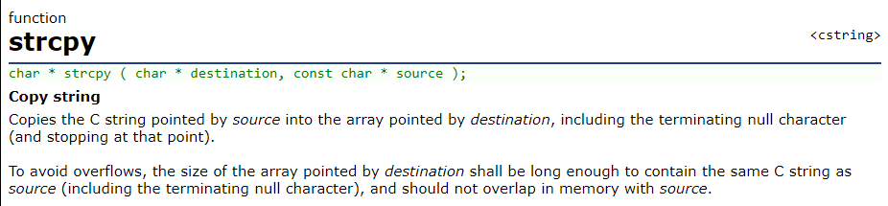
More Notes: strcpy()
char *strcpy(char *dest, const char *src) {
char *tmp = dest;
while ((*dest++ = *src++) != '\0')
/* nothing */;
return tmp;
}

Slide 31
When Overlap Happens: Undefined Behavior
#include <string.h>
#include <stdio.h>
int main(int argc, char* argv[]) {
char b[32];
strcpy(b, "123456789012345");
strcpy(b + 1, b);
printf("[%s]\n", b);
return 0;
}
Visual Studio 2010 64-bit
[1123446788012245]
Copy every 4-byte word
Linux 64-bit
[1123456788012345]
Copy every 8-byte word
Solaris (SPARC)
[1123446788012245]
Copy every 4-byte word
AIX
[1111111111012245]
Per-byte, until last two 4-byte words
HP-UX
[1123456789012345]
Copy from end

Slide 32
How to Fix?
Copy from end to begin
char *strcpy(char *dest, const char *src) {
if (!dest || !src)
return NULL;
char *d = dest;
int size = strlen(src) + 1;
if (d > src && d < src + size) { /* reversely */;
d = d + size - 1;
src = src + size - 1;
while (size--) {
*d-- = *src--;
}
} else { /* as normal */;
while (size--) {
*d++ = *src++;
}
}
}

Slide 33
More Robust: Check Out-of-Boundary
char *strcpy(char *dest, const char *src) {
if (!dest || !src)
return NULL;
char *d = dest;
int size = strlen(src) + 1;
if (d > src && d < src + size) { /* reversely */;
d = d + size - 1;
src = src + size - 1;
while (size--) {
*d-- = *src--;
}
} else { /* as normal */;
while (size--) {
*d++ = *src++;
}
}
}

Slide 34
Example: strcat()
/**
* strcat - Append one %NUL-terminated string to another
* @dest: The string to be appended to
* @src: The string to append to it
*/
char *strcat(char *dest, const char *src) {
char *tmp = dest;
while (*dest)
dest++;
while ((*dest++ = *src++) != '\0')
;
return tmp;
}
https://github.com/raspberrypi/linux/blob/rpi-4.4.y/lib/string.c
34

Slide 35
C++ Implementation
Key: wrap C array
STL is similar but more complicated
class MyString {
private:
char* str;
int size;
public:
MyString();
MyString(char* s);
~MyString();
MyString& operator= (char* s);
MyString& operator= (MyString& s);
MyString operator+ (char* s);
MyString operator+ (MyString& s);
friend MyString operator+ (char* s1, MyString& s);
…
}
https://github.com/gcc-mirror/gcc/blob/master/libstdc++-v3/include/bits/basic_string.h

Slide 36
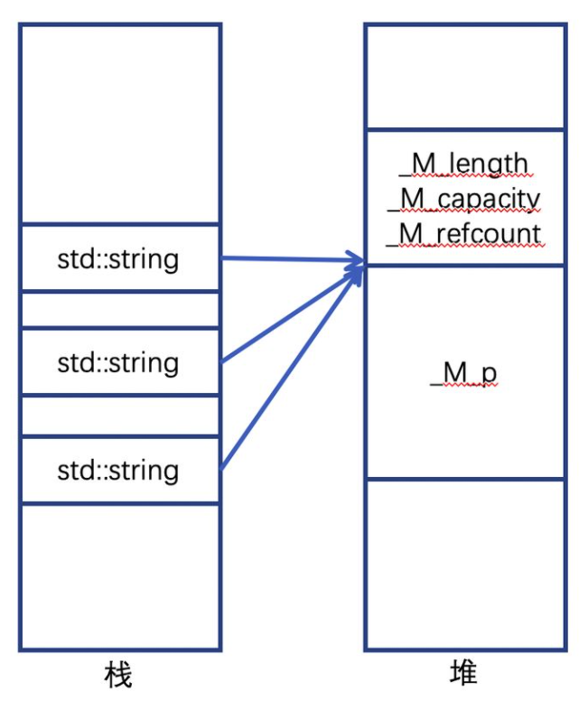
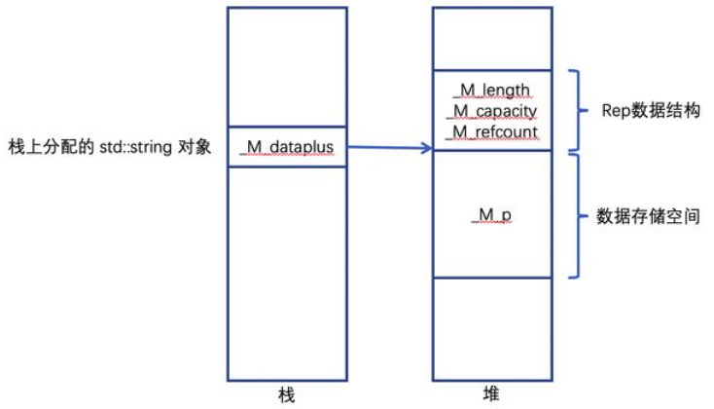
libstc++
Each string has a single field _M_dataplus
Data structure
Copy on Write

Slide 37
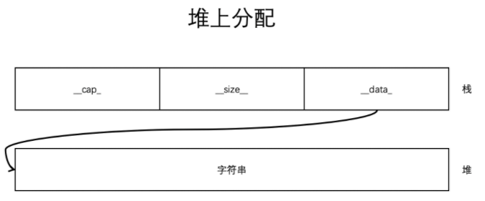
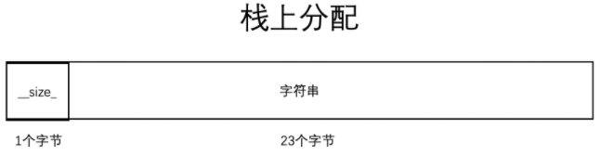
libc++
Long string
Short string

Slide 38
Complexity
Most operations can be implemented in O(1) or linear time
Exception: matching substrings
E.g., strstr() in C

Slide 39
Example: strstr()
/**
* strstr - Find the first substring in a %NUL terminated string
* @s1: The string to be searched
* @s2: The string to search for
*/
char *strstr(const char *s1, const char *s2) {
size_t l1, l2;
l2 = strlen(s2);
if (!l2) return (char *)s1;
l1 = strlen(s1);
while (l1 >= l2) {
l1--;
if (!memcmp(s1, s2, l2)) return (char *)s1;
s1++;
}
return NULL;
}
https://github.com/raspberrypi/linux/blob/rpi-4.4.y/lib/string.c
39

Slide 40
Outline
String
Basic concepts & Operations (ADT)
Implementation
Pattern Matching
40

Slide 41
Pattern Matching
Pattern matching
A target string S (s1 in the last example)
S[1..n] with n characters
A pattern P (s2 in the last example)
P[1..m] with m characters
Task
Find a substring of S, such that
S[p+1…p+m] = P[1..m]
Return the first p (or the last p, or every p)
Return NULL if substring not found
41

Slide 42
Diagram of a Matched String
S | s₀ | s₁ | … | s_{i} | s_{i+1} | s_{i+2} | … | s_{i+m-2} | s_{i+m-1} | … | s_{n-1}
 |  |  |  | || | || | || |  | || | ||
P |  |  |  | p₀ | p₁ | p₂ | … | p_{m-2} | p_{m-1}
42

Slide 43
Naïve Algorithm
i: | 0 | 1 | 2 | 3 | 4 | 5 | 6 | 7 | 8 | 9 | 10 | 11 | 12 | 13 | 14 | 15 | 16 | 17 | 18 | 19 | 20 | 21 | 22
S: | A | B | C |  | A | B | C | D | A | B |  | A | B | C | D | A | B | C | D | A | B | D | E
P: | A | B | C | D | A | B | D
j: | 0 | 1 | 2 | 3 | 4 | 5 | 6
43

Slide 44
Naïve Algorithm
i: | 0 | 1 | 2 | 3 | 4 | 5 | 6 | 7 | 8 | 9 | 10 | 11 | 12 | 13 | 14 | 15 | 16 | 17 | 18 | 19 | 20 | 21 | 22
S: | A | B | C |  | A | B | C | D | A | B |  | A | B | C | D | A | B | C | D | A | B | D | E
P: | A | B | C | D | A | B | D
j: | 0 | 1 | 2 | 3 | 4 | 5 | 6
44

Slide 45
Naïve Algorithm
i: | 0 | 1 | 2 | 3 | 4 | 5 | 6 | 7 | 8 | 9 | 10 | 11 | 12 | 13 | 14 | 15 | 16 | 17 | 18 | 19 | 20 | 21 | 22
S: | A | B | C |  | A | B | C | D | A | B |  | A | B | C | D | A | B | C | D | A | B | D | E
P: |  | A | B | C | D | A | B | D
j: |  | 0 | 1 | 2 | 3 | 4 | 5 | 6
45

Slide 46
Naïve Algorithm
i: | 0 | 1 | 2 | 3 | 4 | 5 | 6 | 7 | 8 | 9 | 10 | 11 | 12 | 13 | 14 | 15 | 16 | 17 | 18 | 19 | 20 | 21 | 22
S: | A | B | C |  | A | B | C | D | A | B |  | A | B | C | D | A | B | C | D | A | B | D | E
P: |  |  | A | B | C | D | A | B | D
j: |  |  | 0 | 1 | 2 | 3 | 4 | 5 | 6
46

Slide 47
Naïve Algorithm
i: | 0 | 1 | 2 | 3 | 4 | 5 | 6 | 7 | 8 | 9 | 10 | 11 | 12 | 13 | 14 | 15 | 16 | 17 | 18 | 19 | 20 | 21 | 22
S: | A | B | C |  | A | B | C | D | A | B |  | A | B | C | D | A | B | C | D | A | B | D | E
P: |  |  |  | A | B | C | D | A | B | D
j: |  |  |  | 0 | 1 | 2 | 3 | 4 | 5 | 6
47

Slide 48
Naïve Algorithm
i: | 0 | 1 | 2 | 3 | 4 | 5 | 6 | 7 | 8 | 9 | 10 | 11 | 12 | 13 | 14 | 15 | 16 | 17 | 18 | 19 | 20 | 21 | 22
S: | A | B | C |  | A | B | C | D | A | B |  | A | B | C | D | A | B | C | D | A | B | D | E
P: |  |  |  |  | A | B | C | D | A | B | D
j: |  |  |  |  | 0 | 1 | 2 | 3 | 4 | 5 | 6
48

Slide 49
Naïve Algorithm
i: | 0 | 1 | 2 | 3 | 4 | 5 | 6 | 7 | 8 | 9 | 10 | 11 | 12 | 13 | 14 | 15 | 16 | 17 | 18 | 19 | 20 | 21 | 22
S: | A | B | C |  | A | B | C | D | A | B |  | A | B | C | D | A | B | C | D | A | B | D | E
P: |  |  |  |  |  | A | B | C | D | A | B | D
j: |  |  |  |  |  | 0 | 1 | 2 | 3 | 4 | 5 | 6
49

Slide 50
Analysis of the Naïve Algorithm
For example,
S = aaaaaaaaaab
P = aaaaaab
Assume S has a length of n, P has a length m, where m ≤ n
In the worst case, every attempt is rejected, and there are (n-m+1) attempts in total
Every attempt performs m comparisons of characters in the worst case
The worst-case time complexity is O(mn)
50

Slide 51
Can We Make it Better?
i: | 0 | 1 | 2 | 3 | 4 | 5 | 6 | 7 | 8 | 9 | 10 | 11 | 12 | 13 | 14 | 15 | 16 | 17 | 18 | 19 | 20 | 21 | 22
S: | A | B | C |  | A | B | C | D | A | B |  | A | B | C | D | A | B | C | D | A | B | D | E
P: |  |  |  |  | A | B | C | D | A | B | D
j: |  |  |  |  | 0 | 1 | 2 | 3 | 4 | 5 | 6
51

Slide 52
Can We Make it Better?
i: | 0 | 1 | 2 | 3 | 4 | 5 | 6 | 7 | 8 | 9 | 10 | 11 | 12 | 13 | 14 | 15 | 16 | 17 | 18 | 19 | 20 | 21 | 22
S: | A | B | C |  | A | B | C | D | A | B |  | A | B | C | D | A | B | C | D | A | B | D | E
P: |  |  |  |  | A | B | C | D | A | B | D
j: |  |  |  |  | 0 | 1 | 2 | 3 | 4 | 5 | 6
Have seen: not possible to match pattern P
52

Slide 53
Can We Make it Better?
i: | 0 | 1 | 2 | 3 | 4 | 5 | 6 | 7 | 8 | 9 | 10 | 11 | 12 | 13 | 14 | 15 | 16 | 17 | 18 | 19 | 20 | 21 | 22
S: | A | B | C |  | A | B | C | D | A | B |  | A | B | C | D | A | B | C | D | A | B | D | E
P: |  |  |  |  | A | B | C | D | A | B | D
j: |  |  |  |  | 0 | 1 | 2 | 3 | 4 | 5 | 6
 |  |  |  |  |  |  |  |  | A | B | C | D | A | B | D
 |  |  |  |  |  |  |  |  | 0 | 1 | 2 | 3 | 4 | 5 | 6
Start from i=8, j=0 (i.e. i=10, j=3) directly
53

Slide 54
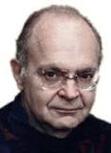


KMP Algorithm
Basic idea
skip the unnecessary comparisons
KMP (1977): efficient and simple-to-implement
Donald Knuth, James Morris, Vaughan Pratt
Twenty Questions for Donald Knuth | | InformIT
54
Notes:
Knuth (Stanford)
Pratt (Stanford): Pratt primality test, median of medians, SUN workstation
Morris (PARC)
Ten years later, I discovered the so-called Knuth-Morris-Pratt algorithm by studying the way one of Steve Cook's automata was able to recognize concatenated palindromes in linear time. Such investigations are fun.
http://www.informit.com/articles/article.aspx?p=2213858

Slide 55
Observation of KMP Algorithm
If p₀ p₁…p_{j-2} ≠ p₁ p₂ … p_{j-1},
we can immediately know
p₀ p₁…p_{j-2} ≠ s_{i-j+1} s_{i-j+2} … s_{i-1}
and skip this comparison (s_{i-j+1} and p₀)
S | s₀ | s₁ | … | s_{i-j-1} | s_{i-j} | s_{i-j+1} | s_{i-j+2} | … | s_{i-2} | s_{i-1} | s_{i} | s_{i+1} | … | s_{n-1}
 |  |  |  |  | || | || | || |  | || | || | ×
P |  |  |  |  | p₀ | p₁ | p₂ | … | p_{j-2} | p_{j-1} | p_{j}
 |  |  |  |  |  | ? | ? | … | ? | ? | ? | ?
naïve algorithm |  |  |  |  |  | p₀ | p₁ | … | p_{j-3} | p_{j-2} | p_{j-1} | p_{j}
55

Slide 56
Observation of KMP Algorithm
In the same way, if
p₀ p₁…p_{j-3} ≠ p₂ p₃ … p_{j-1}
we can also skip the next comparison (s_{i-j+2} and p₀), because
p₀ p₁…p_{j-3} ≠ s_{i-j+2} s_{i-j+3} … s_{i-1}
Until we find a “k” such that
p₀ p₁…p_{k} ≠ p_{j-k-1} p_{j-k} … p_{j-1}
and p₀ p₁…p_{k-1} = p_{j-k} p_{j-k+1} … p_{j-1}
Then p₀ p₁…p_{k-1} = s_{i-k} s_{i-k+1} … s_{i-1}
56

Slide 57
KMP: Key Idea
After failing an attempt (at s_{i} and p_{j})
Naïve matching: start from s_{i-j+1} and p₀
KMP Algorithm
Find a “k”
Start comparison from s_{i} and p_{k}
s_{i-j} | s_{i-j+1} | s_{i-j+2} | … | s_{i-k} | s_{i-k+1} | … | s_{i-1} | s_{i}
|| | || | || |  | || | || |  | || | ×
p₀ | p₁ | p₂ | … | p_{j-k} | p_{j-k+1} | … | p_{j-1} | p_{j}
 | ? | ? |  | ? | ? |  | ? | ?
 | p₀ | p₁ | … | p_{j-k-1} | p_{j-k} | … | p_{j-2} | p_{j-1}
 |  |  |  | || | || |  | || | ?
 |  |  |  | p₀ | p₁ | … | p_{k-1} | p_{k}
Naïve Algorithm
KMP Algorithm
57

Slide 58
Outline
String
Basic concepts & Operations (ADT)
Implementation
Pattern Matching
Naïve Matching
KMP Algorithm
Procedure of matching
Procedure of computing “k” (called N[j] or next[j])
58

Slide 59
Rethink Naïve Matching
Naïve Matching moves i back to i-(j-1) after a fail
s_{i-j} | s_{i-j+1} | s_{i-j+2} | … | s_{i-k} | s_{i-k+1} | … | s_{i-1} | s_{i}
|| | || | || |  | || | || |  | || | ×
p₀ | p₁ | p₂ | … | p_{j-k} | p_{j-k+1} | … | p_{j-1} | p_{j}
 | ? | ? |  | ? | ? |  | ? | ?
 | p₀ | p₁ | … | p_{j-k-1} | p_{j-k} | … | p_{j-2} | p_{j-1}
 |  |  |  | || | || |  | || | ?
 |  |  |  | p₀ | p₁ | … | p_{k-1} | p_{k}
for (i = 0; i < n; ++i) {
for (j = 0; i < n && j < m
&& P[j] == S[i]; ++i, ++j);
if (j == m) return i-m;
i = i – (j – 1); // rewind
}
return -1;
Naïve Algorithm
KMP Algorithm
59

Slide 60
KMP Algorithm
Try to keep i and move pattern
Move i only when necessary
int k = 0;
for (i = 0; i < n;) {
for (j = k; i < n && j < m
&& P[j] == S[i]; ++i, ++j);
if (j == m) return i-m;
if (j == 0) ++i; // move i
else k = N[j]; // move pattern
}
return -1;
s_{i-j} | s_{i-j+1} | s_{i-j+2} | … | s_{i-k} | s_{i-k+1} | … | s_{i-1} | s_{i}
|| | || | || |  | || | || |  | || | ×
p₀ | p₁ | p₂ | … | p_{j-k} | p_{j-k+1} | … | p_{j-1} | p_{j}
 | ? | ? |  | ? | ? |  | ? | ?
 | p₀ | p₁ | … | p_{j-k-1} | p_{j-k} | … | p_{j-2} | p_{j-1}
 |  |  |  | || | || |  | || | ?
 |  |  |  | p₀ | p₁ | … | p_{k-1} | p_{k}
Naïve Algorithm
KMP Algorithm
60

Slide 61
More Compact Source Code
// delete k in previous code
for (i = 0, j = 0; i < n && j < m; ) {
if (P[j]==S[i])
++i, ++j;
else {
if (j==0)
++i; // move i
else j = N[j]; // move pattern
}
}
if (j == m) return i-m;
else return -1;
s_{i-j} | s_{i-j+1} | s_{i-j+2} | … | s_{i-k} | s_{i-k+1} | … | s_{i-1} | s_{i}
|| | || | || |  | || | || |  | || | ×
p₀ | p₁ | p₂ | … | p_{j-k} | p_{j-k+1} | … | p_{j-1} | p_{j}
 |  |  |  | || | || |  | || | ?
 |  |  |  | p₀ | p₁ | … | P_{N[j]-1} | p_{N[j]}
KMP Algorithm

Slide 62
More Compact Source Code
for (i = 0, j = 0; i < n && j < m; ++i) {
// by defining N[0] = –1
if (j==–1 || P[j]==S[i]) ++i, ++j;
else j = N[j];
}
if (j == m) return i-m;
else return -1;
s_{i-j} | s_{i-j+1} | s_{i-j+2} | … | s_{i-k} | s_{i-k+1} | … | s_{i-1} | s_{i}
|| | || | || |  | || | || |  | || | ×
p₀ | p₁ | p₂ | … | p_{j-k} | p_{j-k+1} | … | p_{j-1} | p_{j}
 |  |  |  | || | || |  | || | ?
 |  |  |  | p₀ | p₁ | … | P_{N[j]-1} | p_{N[j]}
KMP Algorithm

Slide 63
Assume We Know N[j]
j | A (j=0) | B (j=1) | C (j=2) | D (j=3) | A (j=4) | B (j=5) | D (j=6)
N[j] | -1 | 0 | 0 | 0 | 0 | 1 | 2
i: | 0 | 1 | 2 | 3 | 4 | 5 | 6 | 7 | 8 | 9 | 10 | 11 | 12 | 13 | 14 | 15 | 16 | 17 | 18 | 19 | 20 | 21 | 22
S: | A | B | C |  | A | B | C | D | A | B |  | A | B | C | D | A | B | C | D | A | B | D | E
P: |  |  |  |  | A | B | C | D | A | B | D
j: |  |  |  |  | 0 | 1 | 2 | 3 | 4 | 5 | 6
i=10, j=6, N[j]=2 -> start from i=10, j=2

Slide 64
Assume We Know N[j]
j | A (j=0) | B (j=1) | C (j=2) | D (j=3) | A (j=4) | B (j=5) | D (j=6)
N[j] | -1 | 0 | 0 | 0 | 0 | 1 | 2
i: | 0 | 1 | 2 | 3 | 4 | 5 | 6 | 7 | 8 | 9 | 10 | 11 | 12 | 13 | 14 | 15 | 16 | 17 | 18 | 19 | 20 | 21 | 22
S: | A | B | C |  | A | B | C | D | A | B |  | A | B | C | D | A | B | C | D | A | B | D | E
P: |  |  |  |  |  |  |  |  | A | B | C | D | A | B | D
j: |  |  |  |  |  |  |  |  | 0 | 1 | 2 | 3 | 4 | 5 | 6
i=10, j=2, N[j]=0 -> start from i=10, j=0

Slide 65
Assume We Know N[j]
j | A (j=0) | B (j=1) | C (j=2) | D (j=3) | A (j=4) | B (j=5) | D (j=6)
N[j] | -1 | 0 | 0 | 0 | 0 | 1 | 2
i: | 0 | 1 | 2 | 3 | 4 | 5 | 6 | 7 | 8 | 9 | 10 | 11 | 12 | 13 | 14 | 15 | 16 | 17 | 18 | 19 | 20 | 21 | 22
S: | A | B | C |  | A | B | C | D | A | B |  | A | B | C | D | A | B | C | D | A | B | D | E
P: |  |  |  |  |  |  |  |  |  |  | A | B | C | D | A | B | D
j: |  |  |  |  |  |  |  |  |  |  | 0 | 1 | 2 | 3 | 4 | 5 | 6
i=10, j=0 -> i=10, j=-1 -> start from i=11, j=0

Slide 66
Assume We Know N[j]
j | A (j=0) | B (j=1) | C (j=2) | D (j=3) | A (j=4) | B (j=5) | D (j=6)
N[j] | -1 | 0 | 0 | 0 | 0 | 1 | 2
i: | 0 | 1 | 2 | 3 | 4 | 5 | 6 | 7 | 8 | 9 | 10 | 11 | 12 | 13 | 14 | 15 | 16 | 17 | 18 | 19 | 20 | 21 | 22
S: | A | B | C |  | A | B | C | D | A | B |  | A | B | C | D | A | B | C | D | A | B | D | E
P: |  |  |  |  |  |  |  |  |  |  |  | A | B | C | D | A | B | D
j: |  |  |  |  |  |  |  |  |  |  |  | 0 | 1 | 2 | 3 | 4 | 5 | 6
i=17, j=6 -> start from i=17, j=2

Slide 67
Assume We Know N[j]
j | A (j=0) | B (j=1) | C (j=2) | D (j=3) | A (j=4) | B (j=5) | D (j=6)
N[j] | -1 | 0 | 0 | 0 | 0 | 1 | 2
i: | 0 | 1 | 2 | 3 | 4 | 5 | 6 | 7 | 8 | 9 | 10 | 11 | 12 | 13 | 14 | 15 | 16 | 17 | 18 | 19 | 20 | 21 | 22
S: | A | B | C |  | A | B | C | D | A | B |  | A | B | C | D | A | B | C | D | A | B | D | E
P: |  |  |  |  |  |  |  |  |  |  |  |  |  |  |  | A | B | C | D | A | B | D
j: |  |  |  |  |  |  |  |  |  |  |  |  |  |  |  | 0 | 1 | 2 | 3 | 4 | 5 | 6
Match! But Can Continue:
i=21, j=6 -> start from i=21, j=2

Slide 68
The Only Problem Remains
How can we know N[j]?
Then we know how much to slide…
Called next[j] in some textbooks

Slide 69
Outline
String
Basic concepts & Operations (ADT)
Implementation
Pattern Matching
Naïve Matching
KMP Algorithm
Procedure of matching
Procedure of computing “k” (called N[j] or next[j])
69

Slide 70
Calculate N[j]
For matching failure at p_{j}
We find a “k” (k<j) such that
p₀ p₁…p_{k} ≠ p_{j-k-1} p_{j-k} … p_{j-1}
and p₀ p₁…p_{k-1} = p_{j-k} p_{j-k+1} … p_{j-1}
Then p₀ p₁…p_{k-1} = s_{i-k} s_{i-k+1} … s_{i-1}
p₀ | p₁ | p₂ | … | p_{j-k} | p_{j-k+1} | … | p_{j-1} | p_{j}
Longest
prefix
=
suffix

Slide 71
Problem Formulation
N[j] =
-1, | j=0
max{ k: 0<k<j & P[0…k-1] = P[j-k…j-1] }, | j>0
Example: ABCDABD
j | P[0…j-1] | Prefix: P[0…k-1], 0<k<j | Suffix: P[j-k…j-1], 0<k<j | N[j]
0
1 | A | {} | {} | 0
2 | AB | {A} | {B} | 0
3 | ABC | {A, AB} | {C, BC} | 0
4 | ABCD | {A, AB, ABC} | {D, CD, BCD} | 0
5 | ABCDA | {A, AB, ABC, ABCD} | {A, DA, CDA, BCDA} | 1
6 | ABCDAB | {A, AB, ABC, ABCD, ABCDE} | {B, AB, DAB, CDAB, BCDAB} | 2

Slide 72
How to Compute Efficiently?
A special case of longest common substring (LCS)
Dynamic programming
N(1) = 0
N(j) is computed using {N(j-1), N(j-2), …, N(1)}
To calculate N(j), let k = N(j-1)
p₀ p₁…p_{k-1} p_{k …} p_{j-k-1} p_{j-k} … p_{j-2} p_{j-1}
72

Slide 73
How to Compute Efficiently?
A special case of longest common substring (LCS)
Dynamic programming
N(1) = 0
N(j) is computed using {N(j-1), N(j-2), …, N(1)}
To calculate N(j), let k = N(j-1)
p₀ p₁…p_{k-1} p_{k …} p_{j-k-1} p_{j-k} … p_{j-2} p_{j-1}
73

Slide 74
How to Compute Efficiently?
A special case of longest common substring (LCS)
Dynamic programming
N(1) = 0
N(j) is computed using {N(j-1), N(j-2), …, N(1)}
To calculate N(j), let k = N(j-1)
p₀ p₁…p_{k-1} p_{k …} p_{j-k-1} p_{j-k} … p_{j-2} p_{j-1}
prefix
=
suffix
74

Slide 75
How to Compute Efficiently?
A special case of longest common substring (LCS)
Dynamic programming
N(1) = 0
N(j) is computed using {N(j-1), N(j-2), …, N(1)}
To calculate N(j), let k = N(j-1)
?=
p₀ p₁…p_{k-1} p_{k …} p_{j-k-1} p_{j-k} … p_{j-2} p_{j-1}
prefix
=
suffix
75

Slide 76
How to Compute Efficiently
If p[k] == p[j-1], N(j) = k+1
=
p₀ p₁…p_{k-1} p_{k …} p_{j-k-1} p_{j-k} … p_{j-2} p_{j-1}
longer prefix
=
longer suffix

Slide 77
How to Compute Efficiently
If p[k] == p[j-1], N(j) = k+1
=
p₀ p₁…p_{k-1} p_{k …} p_{j-k-1} p_{j-k} … p_{j-2} p_{j-1}
longer prefix
=
longer suffix
=
shorter prefix: k=N(N(j-1))
shorter suffix: k=N(N(j-1))
shorter suffix: k=N(N(j-1))
If p[k] != p[j-1],
Search for shorter
From new k=N(k)
Can search recursively
=
!=
p₀ p₁…p_{k-1} p_{k …} p_{j-k-1} p_{j-k} … p_{j-2} p_{j-1}
prefix: k=N(j-1)
=
Suffix: k=N(j-1)

Slide 78
PsudoCode
N[0] = -1;
int k = -1;
for (int j = 1; j <= m; ++j) {
while (k >= 0 && P[k] != P[j-1])
k = N[k]; // ⬄ decrement k
k++;
N[j] = k;
}
return N;
N[0] = -1;
N[1] = 0;
int k = 0;
for (int j = 2; j <= m; ++j) {
while (k >= 0 && P[k] != P[j-1])
k = N[k]; // ⬄ decrement k
k++;
N[j] = k;
}
return N;
Notes:
k = N[j-1] ⬄ k = k+1; when analyzing the complexity

Slide 79
Example (j=2)
?=
j |  |  |  | 2
prefix
P | = | a | b | a | b | a | b | a | c | a | b | a | a | a
suffix
N | = | -1 | 0 | 0
k=0
P[k]=a, P[j-1]=b
79

Slide 80
Example (j=2)
?=
j |  |  |  | 2
prefix
P | = | a | b | a | b | a | b | a | c | a | b | a | a | a
suffix
N | = | -1 | 0 | 0
k = N[k] = -1 -> N[j] = ++k = 0
80

Slide 81
Example (j=3)
?=
j |  |  |  |  | 3
prefix
P | = | a | b | a | b | a | b | a | c | a | b | a | a | a
suffix
N | = | -1 | 0 | 0
k=0
P[k]=a, P[j-1]=a
81

Slide 82
Example (j=3)
?=
j |  |  |  |  | 3
prefix
P | = | a | b | a | b | a | b | a | c | a | b | a | a | a
suffix
N | = | -1 | 0 | 0 | 1
k=0
P[k]=a, P[j-1]=a -> N[j] = ++k = 1
82

Slide 83
Example (j=4)
?=
j |  |  |  |  |  | 4
prefix |  | p₀
P | = | a | b | a | b | a | b | a | c | a | b | a | a | a
suffix |  |  |  | p₀
N | = | -1 | 0 | 0 | 1
k=1
P[k]=b, P[j-1]=b
83

Slide 84
Example (j=4)
?=
j |  |  |  |  |  | 4
prefix |  | p₀
P | = | a | b | a | b | a | b | a | c | a | b | a | a | a
suffix |  |  |  | p₀
N | = | -1 | 0 | 0 | 1 | 2
k=1
P[k]=b, P[j-1]=b -> N[j] = ++k = 2
84

Slide 85
Example (j=5)
?=
j |  |  |  |  |  |  | 5
prefix |  | p₀ | p₁
P | = | a | b | a | b | a | b | a | c | a | b | a | a | a
suffix |  |  |  | p₀ | p₁
N | = | -1 | 0 | 0 | 1 | 2
k=2
P[k]=a, P[j-1]=a
85

Slide 86
Example (j=5)
?=
j |  |  |  |  |  |  | 5
prefix |  | p₀ | p₁
P | = | a | b | a | b | a | b | a | c | a | b | a | a | a
suffix |  |  |  | p₀ | p₁
N | = | -1 | 0 | 0 | 1 | 2 | 3
k=2
P[k]=a, P[j-1]=a -> N[j] = ++k = 3
86

Slide 87
Example (j=6)
?=
j |  |  |  |  |  |  |  | 6
prefix |  | p₀ | p₁ | p₂
P | = | a | b | a | b | a | b | a | c | a | b | a | a | a
suffix |  |  |  | p₀ | p₁ | p₂
N | = | -1 | 0 | 0 | 1 | 2 | 3
k=3
P[k]=b, P[j-1]=b
87

Slide 88
Example (j=6)
?=
j |  |  |  |  |  |  |  | 6
prefix |  | p₀ | p₁ | p₂
P | = | a | b | a | b | a | b | a | c | a | b | a | a | a
suffix |  |  |  | p₀ | p₁ | p₂
N | = | -1 | 0 | 0 | 1 | 2 | 3 | 4
k=3
P[k]=b, P[j-1]=b -> N[j] = ++k = 4
88

Slide 89
Example (j=7)
?=
j |  |  |  |  |  |  |  |  | 7
prefix |  | p₀ | p₁ | p₂ | p₃
P | = | a | b | a | b | a | b | a | c | a | b | a | a | a
suffix |  |  |  | p₀ | p₁ | p₂ | p₃
N | = | -1 | 0 | 0 | 1 | 2 | 3 | 4
k=4
P[k]=a, P[j-1]=a
89

Slide 90
Example (j=7)
?=
j |  |  |  |  |  |  |  |  | 7
prefix |  | p₀ | p₁ | p₂ | p₃
P | = | a | b | a | b | a | b | a | c | a | b | a | a | a
suffix |  |  |  | p₀ | p₁ | p₂ | p₃
N | = | -1 | 0 | 0 | 1 | 2 | 3 | 4 | 5
k=4
P[k]=a, P[j-1]=a -> N[j] = ++k = 5
90

Slide 91
Example (j=8)
?=
j |  |  |  |  |  |  |  |  |  | 8
prefix |  | p₀ | p₁ | p₂ | p₃ | p₄
P | = | a | b | a | b | a | b | a | c | a | b | a | a | a
suffix |  |  |  | p₀ | p₁ | p₂ | p₃ | p₄
N | = | -1 | 0 | 0 | 1 | 2 | 3 | 4 | 5
k=5
P[k]=b, P[j-1]=c
91

Slide 92
Example (j=8)
?=
j |  |  |  |  |  |  |  |  |  | 8
prefix |  | p₀ | p₁ | p₂
P | = | a | b | a | b | a | b | a | c | a | b | a | a | a
suffix |  |  |  |  |  | p₀ | p₁ | p₂
N | = | -1 | 0 | 0 | 1 | 2 | 3 | 4 | 5
k=5 -> k=N[k]=3
P[k]=b, P[j-1]=c
92

Slide 93
Example (j=8)
j |  |  |  |  |  |  |  |  |  | 8
prefix |  | p₀
P | = | a | b | a | b | a | b | a | c | a | b | a | a | a
suffix |  |  |  |  |  |  |  | p₀
N | = | -1 | 0 | 0 | 1 | 2 | 3 | 4 | 5
?=
k=3 -> k=N[k]=1
P[k]=b, P[j-1]=c
93

Slide 94
Example (j=8)
j |  |  |  |  |  |  |  |  |  | 8
prefix
P | = | a | b | a | b | a | b | a | c | a | b | a | a | a
suffix
N | = | -1 | 0 | 0 | 1 | 2 | 3 | 4 | 5
?=
k=1 -> k=N[k]=0
P[k]=a, P[j-1]=c
94

Slide 95
Example (j=8)
j |  |  |  |  |  |  |  |  |  | 8
prefix
P | = | a | b | a | b | a | b | a | c | a | b | a | a | a
suffix
N | = | -1 | 0 | 0 | 1 | 2 | 3 | 4 | 5 | 0
?=
k=0 -> k=N[0]=-1 -> N[j] = ++k = 0
95

Slide 96
Example: Complete
P | = | a | b | a | b | a | b | a | c | a | b | a | a | a
N | = | -1 | 0 | 0 | 1 | 2 | 3 | 4 | 5 | 0 | 1 | 2 | 3 | 1
96

Slide 97
Is it enough? More optimization?

Slide 98
Revisit Matching Procedure
With N[j], we can move P by (j-k)
s_{i-j} | s_{i-j+1} | s_{i-j+2} | … | s_{i-k} | s_{i-k+1} | … | s_{i-1} | s_{i}
|| | || | || |  | || | || |  | || | ×
p₀ | p₁ | p₂ | … | p_{j-k} | p_{j-k+1} | … | p_{j-1} | p_{j}
 |  |  |  | || | || |  | || | ?
 |  |  |  | p₀ | p₁ | … | p_{k-1} | p_{k}
Next comparison: s_{i} ?= p_{k}
But, if we know: p_{j} ?= p_{k}, it can be done better
p_{j} != p_{k}
p_{j} == p_{k}
As before
s_{i} != p_{k} , don’t need to compare skip more: j = N[k]

Slide 99
The Optimized Algorithm
Optimize more skip in N[j]
N[0] = -1;
int k = -1;
for (int j = 1; j <= m; ++j) {
while (k >= 0 && P[k] != P[j-1])
k = N[k]; // ⬄ decrement k
k++;
N[j] = k;
}
return N;
N[0] = -1;
int k = -1;
for (int j = 1; j <= m; ++j) {
while (k >= 0 && P[k] != P[j-1])
k = N[k]; // ⬄ decrement k
k++;
if (P[k] == P[j]) N[j] = N[k];
else N[j] = k;
}
return N;

Slide 100
Example
j | 0 | 1 | 2 | 3 | 4 | 5 | 6 | 7 | 8
P | a | b | c | a | a | b | a | b | c
k | -1 | 0 | 0 | 0 | 1 | 1 | 2 | 1 | 2
p_{k}?=p_{j} |  | ≠ | ≠ | = | ≠ | = | ≠ | = | =
N[j] | -1 | 0 | 0 | -1 | 1 | 0 | 2 | 0 | 0

Slide 101
Outline
String
Basic concepts & Operations (ADT)
Implementation
Pattern Matching
Naïve Matching
KMP Algorithm
Procedure of matching
Procedure of computing “k” (called N[j] or next[j])
Putting It Together
101

Slide 102
Putting It Together
Given target string S and pattern P, KMP Algorithm consists of 2 procedures
Calculate N[0…m] based on P (Preprocessing)
Search using N[0…m] (Matching)
Preprocessing
N[0] = -1;
int k = -1;
for (int j = 1; j <= m; ++j) {
while (k >= 0 && P[k] != P[j-1])
k = N[k]; // ⬄ decrement k
k++;
if (P[k] == P[j]) N[j] = N[k];
else N[j] = k;
}
return N;
Matching
for (i = 0, j = 0; i < n && j < m; ++i) {
// by defining N[0] = –1
if (j==–1 || P[j]==S[i]) ++i, ++j;
else j = N[j];
}
if (j == m) return i-m;
else return -1;

Slide 103
Complexity Analysis
Space complexity: O(m) for N[0…m]
Time complexity: sum of
Preprocessing, and
Matching

Slide 104
Complexity of Preprocessing
N[0] = -1;
int k = -1;
for (int j = 1; j <= m; ++j) {
while (k >= 0 && P[k] != P[j-1])
k = N[k]; // ⬄ decrement k
k++;
if (P[k] == P[j]) N[j] = N[k];
else N[j] = k;
}
return N;
Depends on the while loop
(Proof by contradiction) the statement “k = N[k]” executes at most m times, otherwise:
“k = N[k]” decreases k by at least one
Only the “k++” statement increases k
If “k = N[k]” executes more than m times, the final value of k will be negative, which is impossible
Time complexity of preprocessing is O(m)
Execute at most m times
Execute at most m times
104

Slide 105
Complexity of Matching
Execute at most n times
(Proof by contradiction) The statement “j = N[j]” executes at most n times, otherwise:
“j = N[j]” decreases j by at least one
Only the “++j” statement increases j, but it executes at most n times
If “j = N[j]” executes more than n times, the final value of j will be negative, which is impossible (j is -1 at times, but increases soon in the next iteration)
Therefore, the complexity of matching is O(n)
for (i = 0, j = 0; i < n && j < m; ) {
// by defining N[0] = –1
if (j==–1 || P[j]==S[i]) ++i, ++j;
else j = N[j];
}
if (j == m) return i-m;
else return -1;
105

Slide 106
Final Complexity
Space complexity: O(m) for N[0…m]
Time complexity: O(m + n)

Slide 107
Outline
String
Basic concepts & Operations (ADT)
Implementation
Pattern Matching
Naïve Matching
KMP Algorithm
Procedure of matching
Procedure of computing “k” (called N[j] or next[j])
Putting It Together
More Algorithms
107

Slide 108
KMP In Practice
KMP is even slower than Naïve Matching in many scenarios
“Flexible Pattern Matching in Strings” Gonzalo Navarro, Mathieu Raffinot

Slide 109
More Algorithms
Algorithms | Preprocessing | Matching
Naïve | 0 | Θ(n m)
KMP | Θ(m) | Θ(n)
BM | Θ(m) | Best (n/m), Worst Θ(nm)
(shift-or, shift-and) | Θ(m+|Σ|) | Θ(n)
Rabin-Karp | Θ(m) | Average (n+m), Worst Θ(nm)
FSM | Θ(m |Σ|) | Θ(n)
Widely used in text editors
Good for hardware

Slide 110
More Matching Tasks and Algorithms
Matching a single pattern
Match prefix first: KMP, Shift-And, Shift-Or, Aho-Corasick
Match suffix first: Boyer-Moore (BM), Commentz-Walter
Match best factor first: BNDM, BOM, Set-BOM
Other: Naïve, Rabin-Karp
Matching multiple patterns
Extended string matching
Regular expression matching
Approximate matching

Slide 111
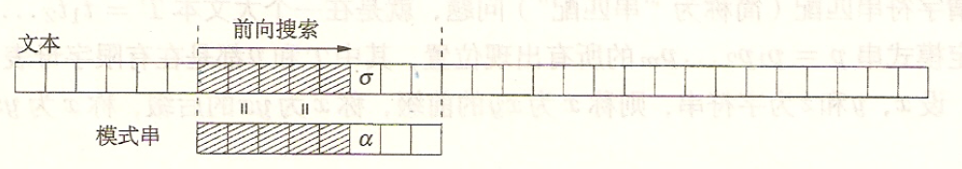
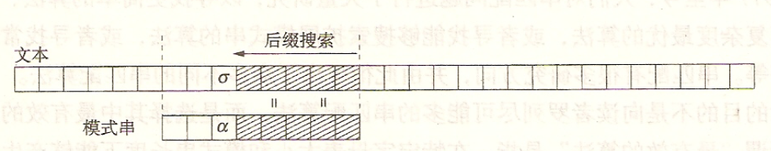
Prefix First and Suffix First

Slide 112

BM Algorithm: Key Idea
Find substring P in string S
Key idea
Suffix First Matching
Skip bad character
Skip good suffix

Slide 113
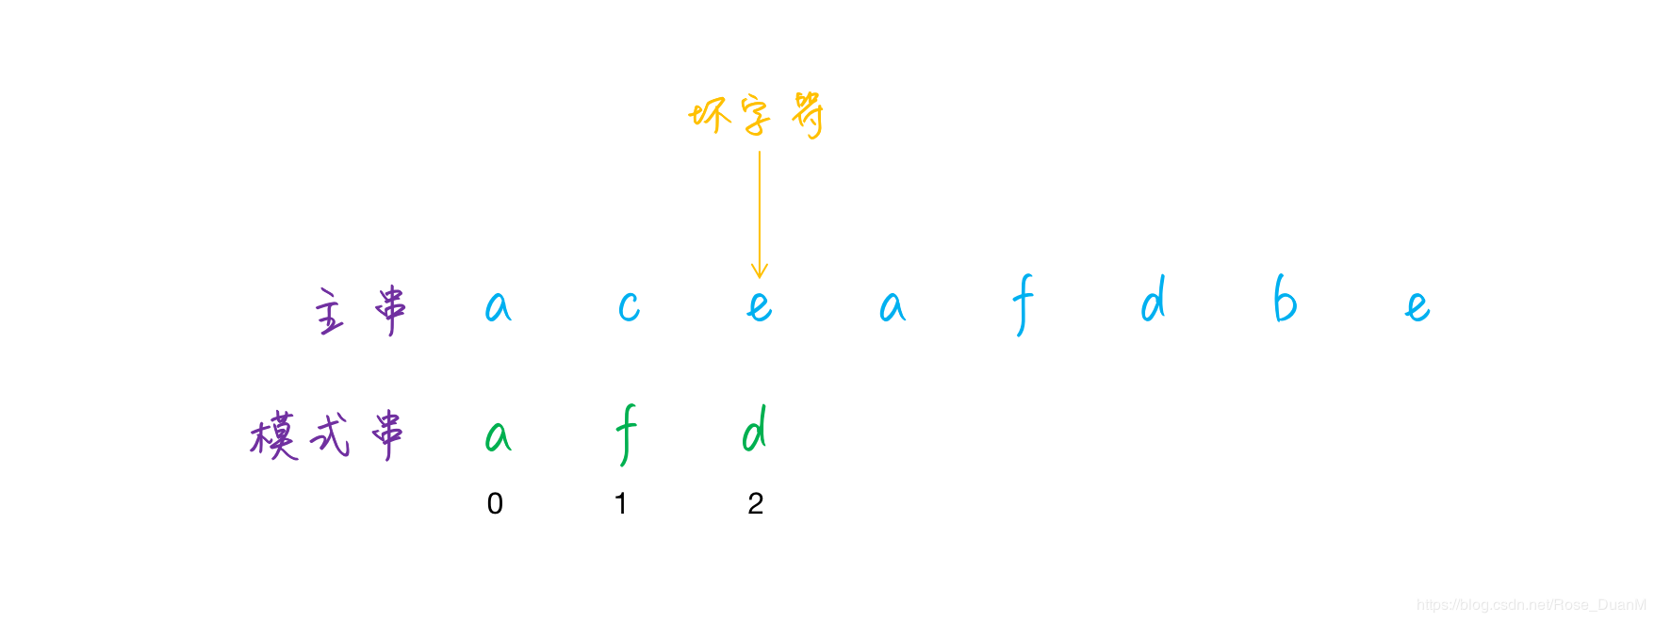
BM Algorithm: Bad Character
When a mismatching occurs, the character in S is a “bad character”

Slide 114
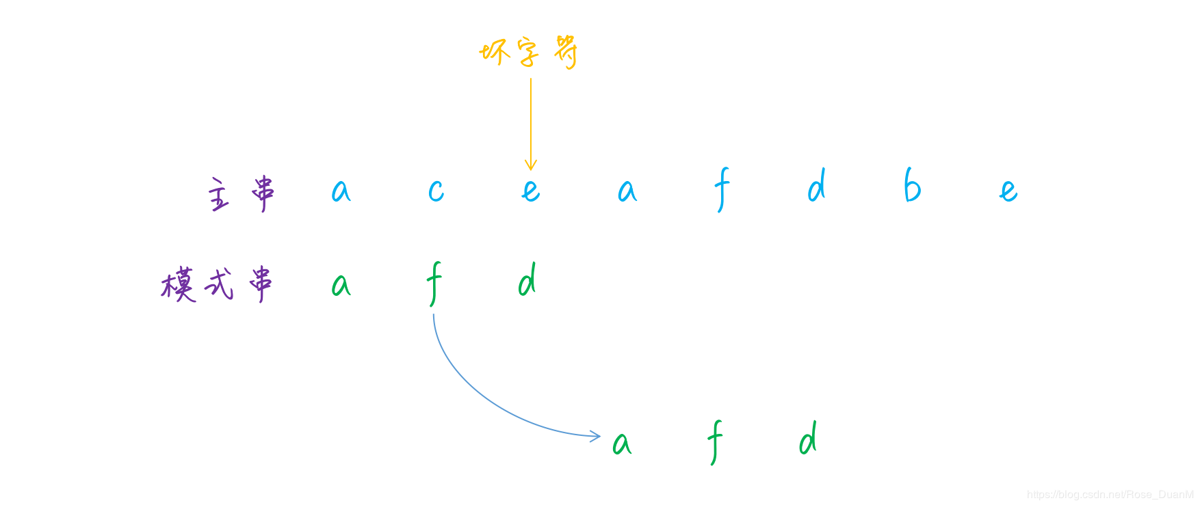
BM Algorithm: Bad Character
Bad Character Case 1: the bad character not in pattern P
Move whole pattern P after the bad character

Slide 115
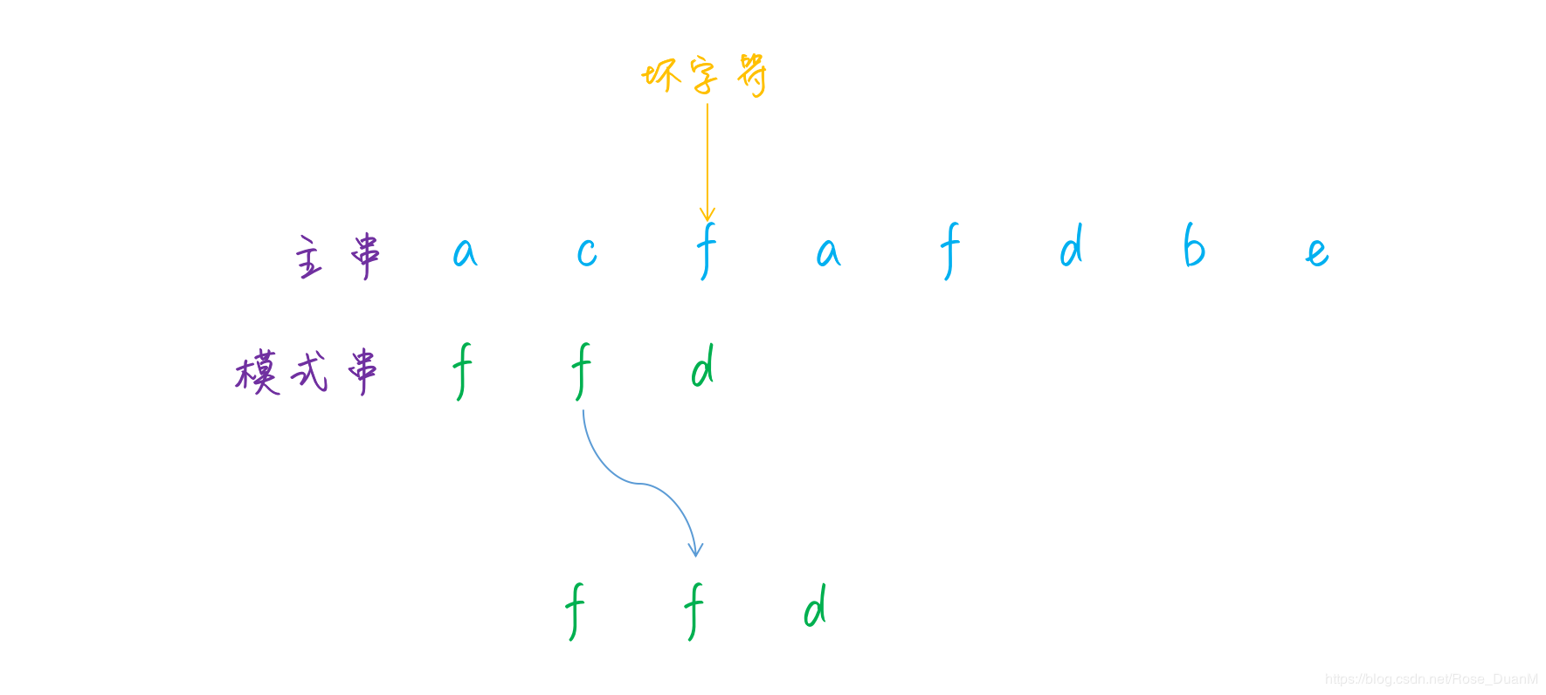
BM Algorithm: Bad Character
Bad Character Case 2: the bad character also in pattern P
Align the bad character with the nearest character in P

Slide 116
BM Algorithm: Bad Character
How to know the number of characters we can move?
Preprocess the pattern, maintain the result in an array or hash table

Slide 117
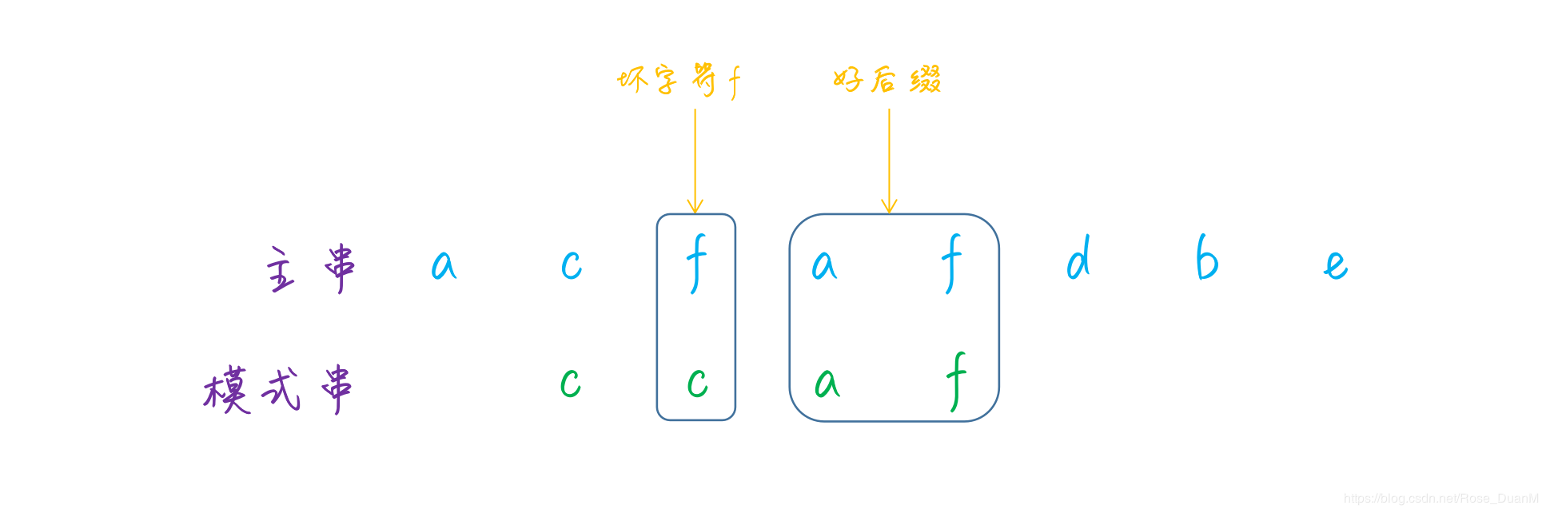
BM Algorithm: Good Suffix
When a mismatching occurs, if there is a substring matched, the substring is a “good suffix”

Slide 118
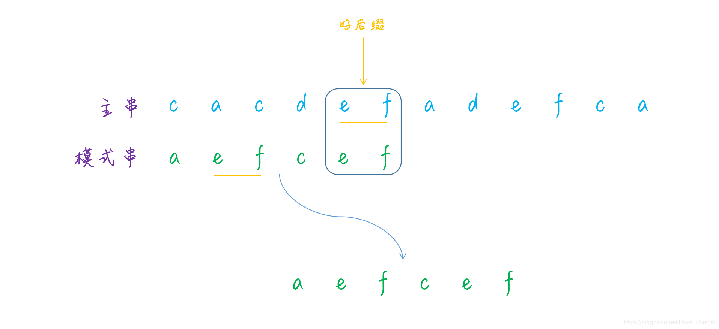
BM Algorithm: Good Suffix
Good Suffix Case 1: the good suffix has other occurrences in pattern P
Align the good suffix with the nearest suffix in P

Slide 119
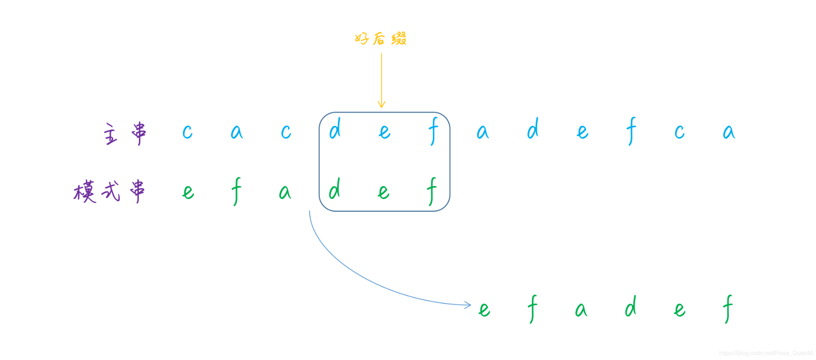
BM Algorithm: Good Suffix
Good Suffix Case 2: the good suffix has no other occurrences in pattern P
Warning: cannot move whole P after the good suffix

Slide 120
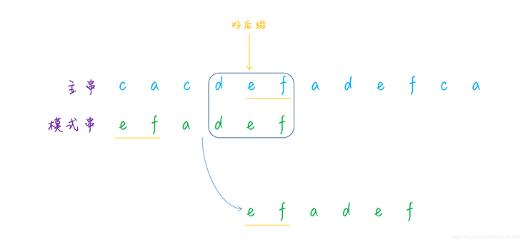
BM Algorithm: Good Suffix
Good Suffix Case 2: the good suffix has no other occurrences in pattern P
We should examine whether suffix of the good suffix equals to prefix of P
suffix of the good suffix is also the suffix of P

Slide 121
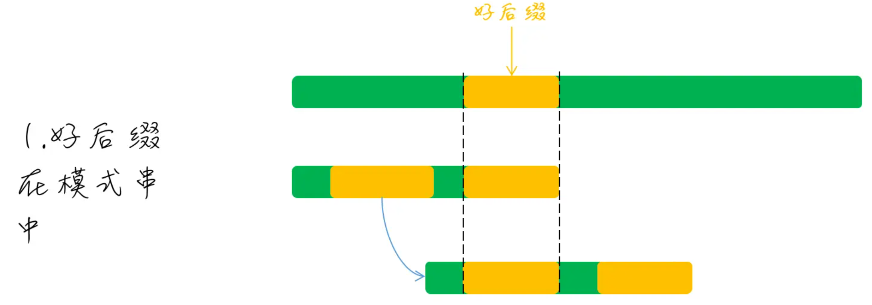
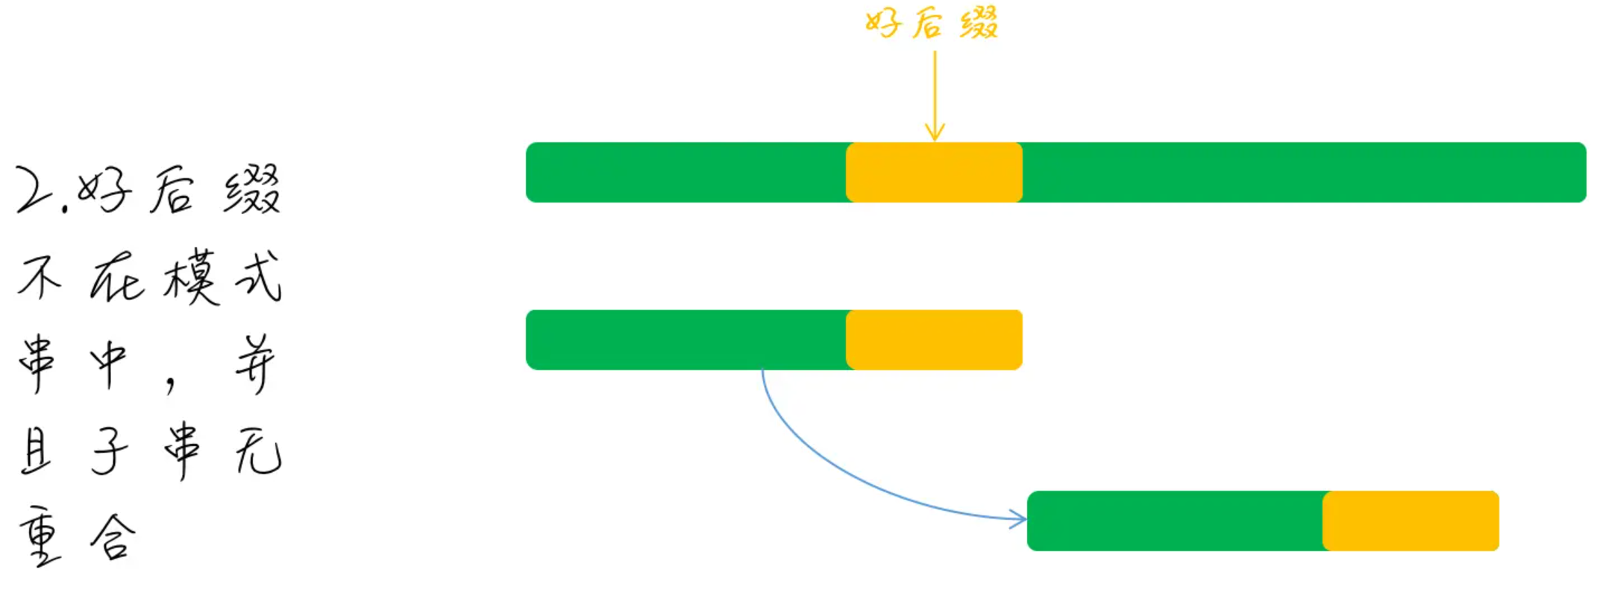
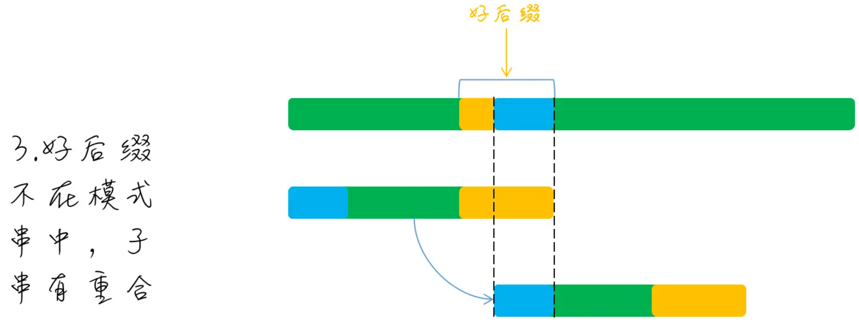
BM Algorithm: Good Suffix

Slide 122
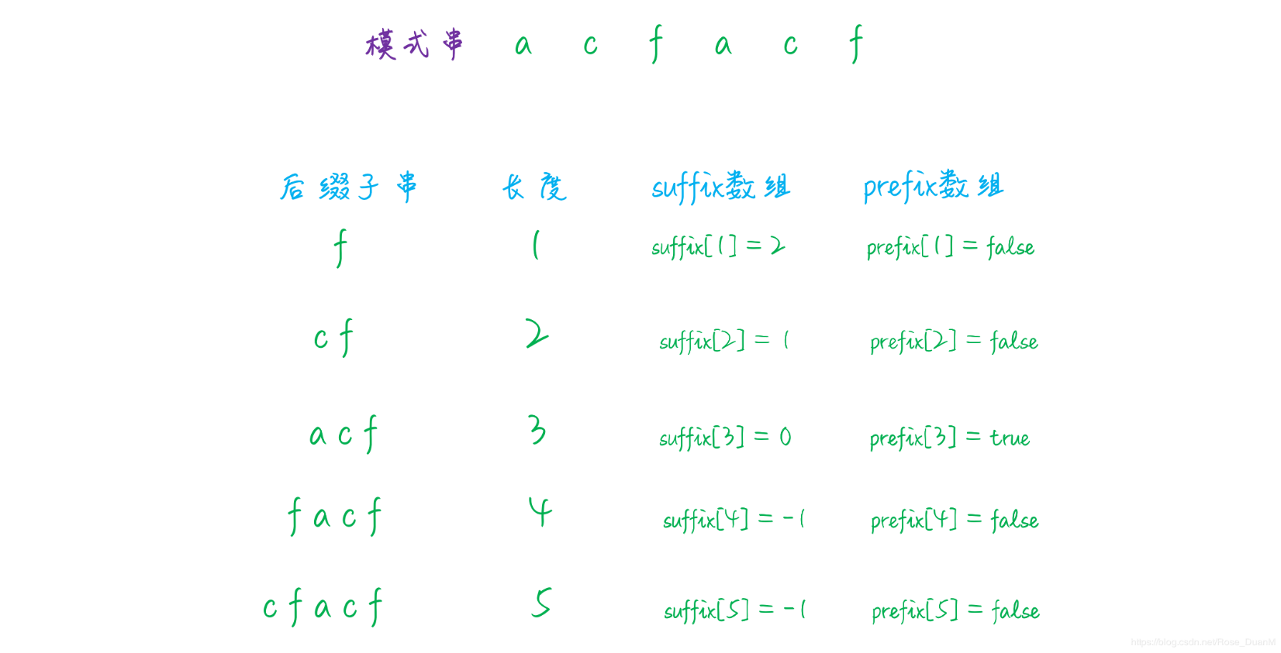
BM Algorithm: Good Suffix
For each possible good suffix (i.e., suffix of P), we need
A int array, indicating the position of the nearest occurrence (for case 1)
A boolean array prefix, indicating whether the suffix has matched prefix in P (for case 2)

Slide 123
BM Algorithm: Putting It Together
When a mismatching occurs
Calculate moves with bad character rules
Calculate moves with good suffix rules
Take the maximum # of moves

Slide 124
Shift-And Algorithm
Find substring P in string S
Key idea: after matching s_{i}, maintain a set D:
D = {x | x is a prefix of P, and x is a suffix of s₀s_{1…}s_{i}}
i: | 0 | 1 | 2 | 3 | 4 | 5 | 6 | 7 | 8 | 9 | 10 | 11 | 12 | 13 | 14
S: | A | G | A | T | A | C | G | A | T | A | T | A | T | A | C
P: |  |  |  |  |  | A | T | A | T | A
D = {A, ATA}

Slide 125
Shift-AND: Skeleton
Two questions:
How to represent D?
How to update D?
int n = strlen(S);
int m = strlen(P);
D = empty set
for (int i=0; i<n; i++;) {
update D;
if D has an element of length m:
report a match at i-m+1;
}

Slide 126
Shift-AND: Represent the Set D
D is a binary sequence of length m
D= d_{m} d_{m-1 …} d₁
d_{j} =1 if and only if p₀p₁ …p_{j-1} is a suffix of s₀ s_{1 …}s_{i-1}
i: | 0 | 1 | 2 | 3 | 4 | 5 | 6 | 7 | 8 | 9 | 10 | 11 | 12 | 13 | 14
S: | A | G | A | T | A | C | G | A | T | A | T | A | T | A | C
P: |  |  |  |  |  | A | T | A | T | A
D = 00101

Slide 127
Shift-AND: Update D
When move from s_{i-1} to s_{i}, new D depends on s_{i}
(new)d_{j}=1 if and only if (old)d_{j-1}=1 and s_{i}=p_{j}
D= ((D << 1) | 0^{m-1}1) & f(s_{i})
For any character x, f(x) is also a binary sequence,
f(x)_{m-j} is 1, if and only if x=p_{j}
Compute f(x) in preprocessing
for (any character c in character set Σ)
f[c] = 0^{m}
for (int j=0; j<m; j++)
f[p_{j}] = f[p_{j}] | 0^{m-j}10^{j-1}

Slide 128
Shift-AND: Example
f [A] = 10101
f [T] = 01010
f [*] = 00000, others
i: | 0 | 1 | 2 | 3 | 4 | 5 | 6 | 7 | 8 | 9 | 10 | 11 | 12 | 13 | 14
S: | A | G | A | T | A | C | G | A | T | A | T | A | T | A | C
P: |  |  |  |  |  | A | T | A | T | A
D = 00101

Slide 129
Shift-AND: Example
f [A] = 10100
f [T] = 01010
f [*] = 00000, others
i: | 0 | 1 | 2 | 3 | 4 | 5 | 6 | 7 | 8 | 9 | 10 | 11 | 12 | 13 | 14
S: | A | G | A | T | A | C | G | A | T | A | T | A | T | A | C
P: |  |  |  |  |  |  | A | T | A | T | A
f [T]
D = ((00101 << 1) | 0^{m-1}1) & 01010 = 01010

Slide 130
Shift-AND: Putting It Together
for (any character c in character set Σ)
f[c] = 0^{m}
for (int j=0; j<m; j++)
f[pj] = f[pj] | 0^{m-j}10^{j-1}
int n = strlen(S);
int m = strlen(P);
D = 0^{m}
for (int i=0; i<n; i++;) {
D= ((D << 1) | 0^{m-1}1) & f(s_{i});
if D && 10^{m-1} != 0:
report a match at i-m+1;
}

Slide 131
Shift-AND: Analysis
Time complexity: Θ(m+|Σ|) + Θ(n)
Θ(m+|Σ|) for preprocessing
Θ(n) for matching
Benefits: simple bit operations
Can be implemented in restricted hardware (e.g., switches & routers)
Can be accelerated by parallelism techniques (e.g., SIMD instructions in modern CPUs)
Shift-Or Algorithm: D[j]=0->prefix

Slide 132
Recommended Readings
Strings
Character sequences
http://www.cplusplus.com/doc/tutorial/ntcs/
C strings
http://www.cplusplus.com/reference/clibrary/cstring/
C++ strings library
http://www.cplusplus.com/reference/string/
KMP Algorithm
http://www.ics.uci.edu/~eppstein/161/960227.html
Source code
https://github.com/raspberrypi/linux/blob/rpi-4.4.y/lib/string.c
glibc-2.24: string/str-two-way.h
132

Slide 133
Summary
String: linear list of characters
Pattern matching
Naïve matching
KMP algorithm
Computing
Matching procedure
Complexity analysis
More algorithms
Shift-And

Slide 134
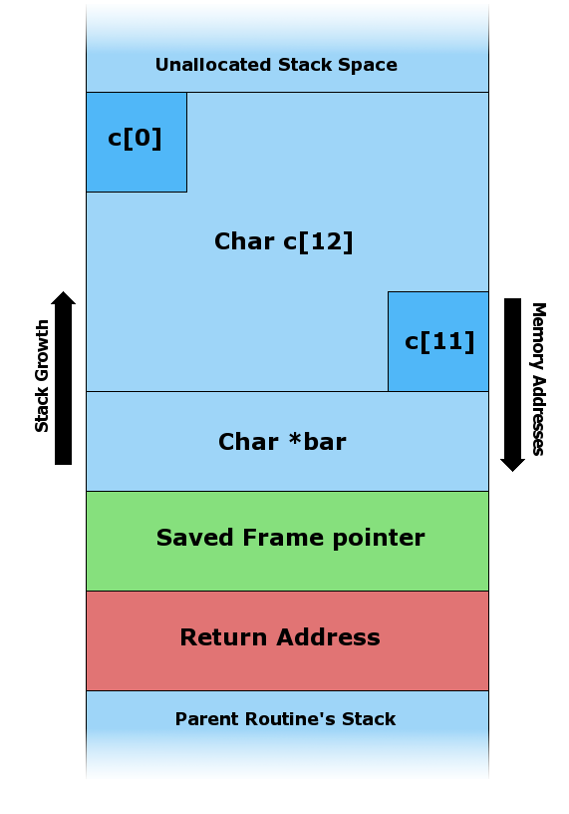
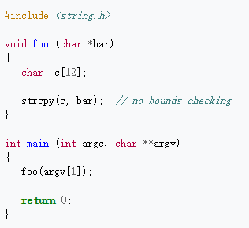
A Security Perspective on Call Stack

Slide 135
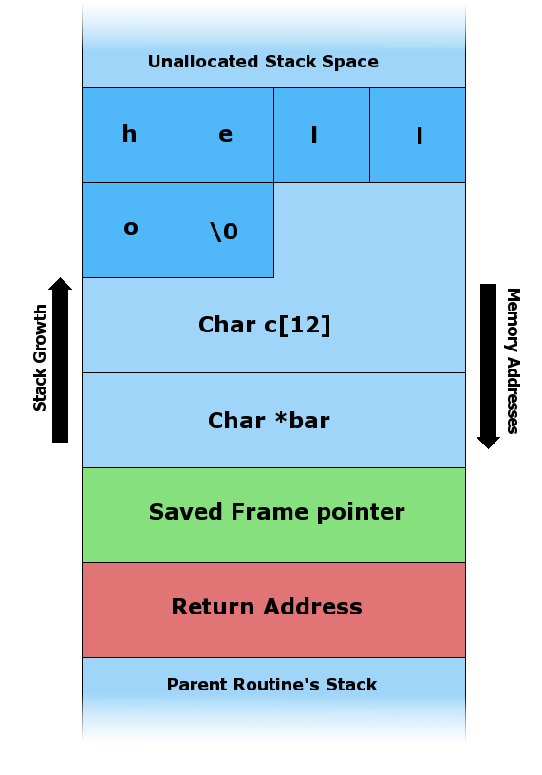
hello\0
A legal call

Slide 136
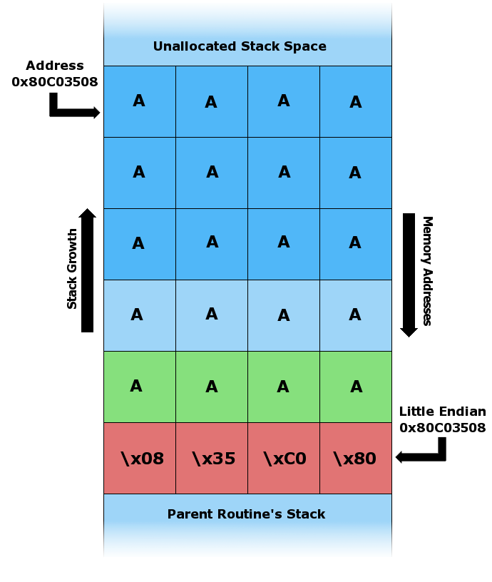
A legal call
An illegal call intending to run bad codes
“Smashing stacks for fun and profit” Aleph One, 1996

